Slide 1


Azure Integration Services
A Beginners guide to building scale-able integration solutions
Mandar Dharmadhikari

Slide 2




Who am I?
Technical Consultant at Chamonix IT Consulting Pty Ltd, Adelaide, South Australia
Integration and AI enthusiast
TechNet Wiki Ninja and Author
Blogger at https://www.theabodeofcode.com
Die Hard Metallica, Dragon Ball and GOT fan
Budding cook
mandardhikari
@theabodeofcode
https://au.linkedin.com/in/mandar-dharmadhikari

Slide 3
Takeaways from the Session
Why are integration solutions required
Components of Azure Integration Services
Azure Logic Apps
Azure Functions
Azure Service Bus
Azure Event Grids
Azure API Management
Common Integration Scenarios & Demos
Reading Resources

Slide 4
What is Integration
In a complex ecosystem, no application can work in silo
Various systems need to have communication between them
Through the unification, the systems provide business value to stakeholders
Integration provides the ability to unify the disparate systems in ecosystem to deliver the value
Integration Services

Slide 5
Expectations from Modern Integration Platforms
Ability to securely expose APIs to external and internal systems
Ability to orchestrate processes and automate tasks
Secure and reliable messaging system to enable cross systems communications
Ability to support reactive style of programming via use of events
Easy to develop
Less on boarding time for developers
Codeless as much as possible
Should support old integration patterns as well as modern ones

Slide 6




Azure Integration Service Components
Azure API Management
Azure Logic Apps
Azure Service Bus
Azure Event Grid

Slide 7

Azure Integration Service Vision
Easy to develop
Codeless as much as possible
Integration Platform as Service to enable faster development and release of products
To be leader in the field of integration

Slide 8
Logic Apps
Integration Platform as a Service
Completely Serverless
Supports data, B2B, Application and Enterprise integrations
Designer First approach of Development
Easy to develop
300 + in built connectors for various systems for light weight integration
Pay-as-you go structure

Slide 9

Azure Functions
Serverless Compute Service
Has plethora of triggers and bindings to integrate with various Azure Services
Developer Oriented
Supports Local Debugging and Testing
Supports containerizations and production slots
Can be run on fixed price App Service Plans or Consumption Based plans

Slide 10
Azure Service Bus
Fully managed enterprise messaging service.
Highly reliable and scalable
Supports FIFO, Pub-Sub patterns through Queues and Topics
Secure access to On premises as well as cloud systems for hybrid integrations

Slide 11
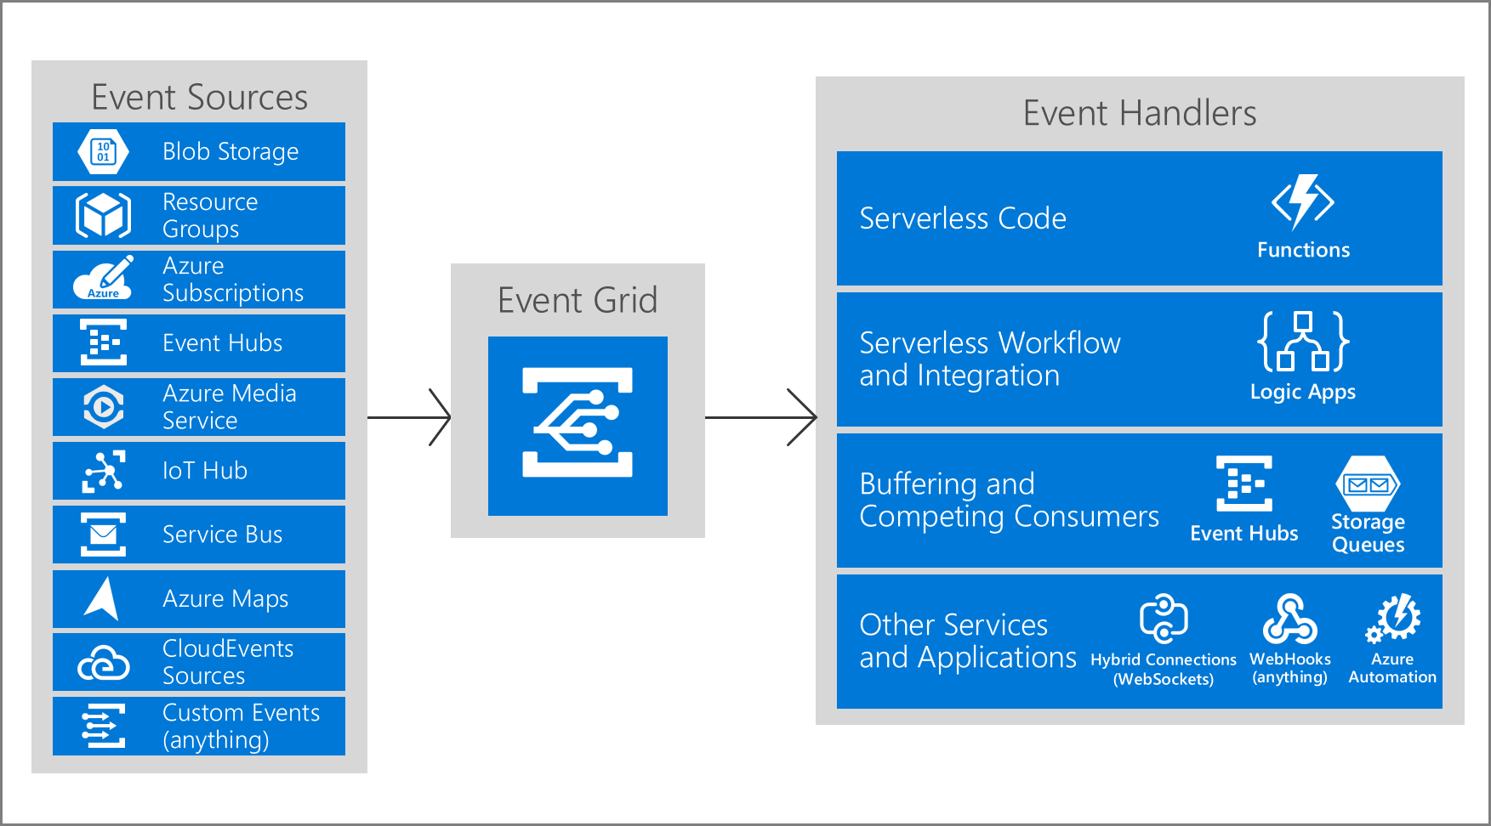
Azure Event Grid
Fully Managed Event Routing Service
Helps build event driven solutions using Pub-Sub Model
Promotes Loosely Coupled Architecture style
Supports Built In as Well as Custom Events
Has a very High Throughput
Pay Per Event Billing Model
Fairly cheap

Slide 12
Azure API Management
Securely expose APIs to external and internal worlds
Helps make APIs marketable and discoverable
Supports subscription and product-based access to APIs
Highly customizable behavior through policy engine
Highly customizable developer portal to access the APIs

Slide 13
Demos

Slide 14
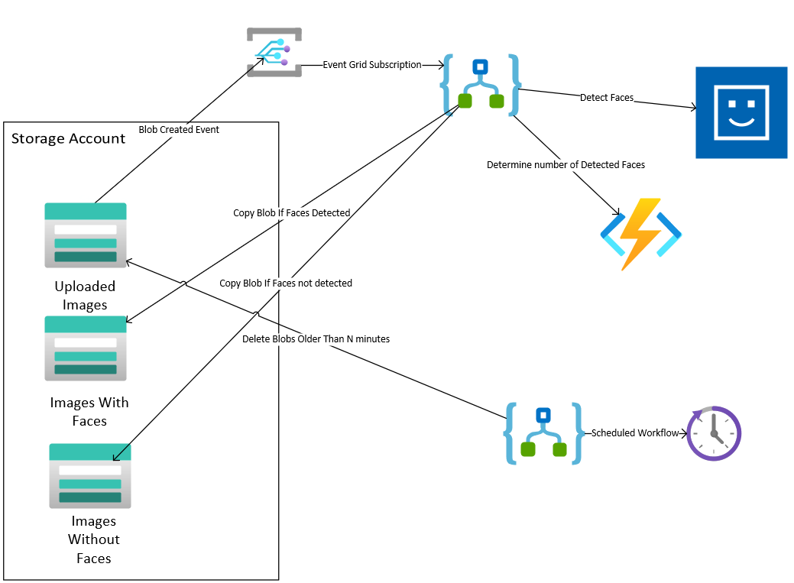
Image Management Workflow

Slide 15
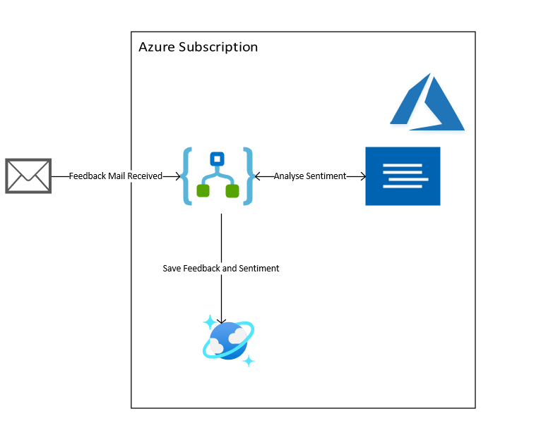
Intelligent Feedback Analyzer

Slide 16
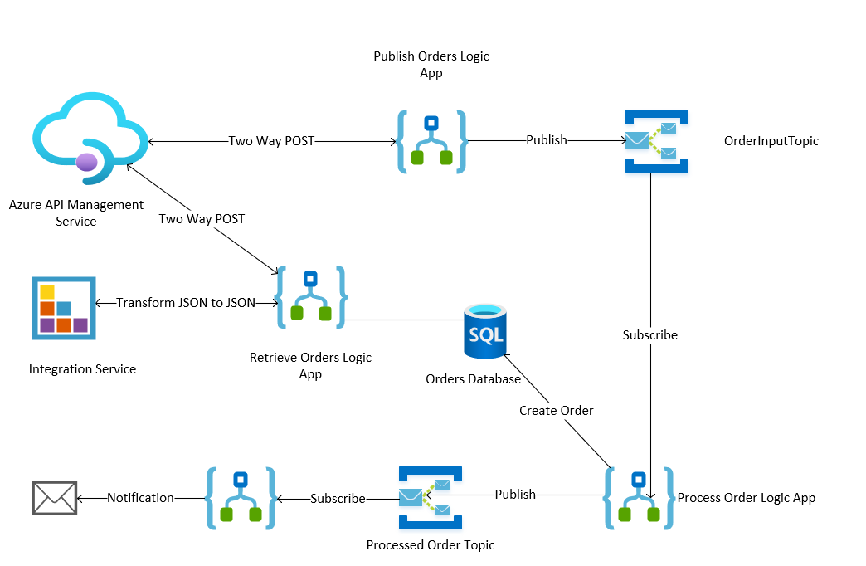
Orders Microservice

Slide 17
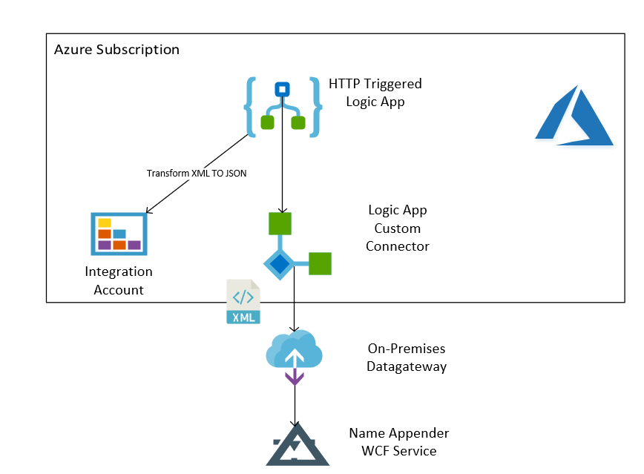
Hybrid Integration

Slide 18
Reading Resources
https://azure.microsoft.com/en-us/services/api-management/
https://azure.microsoft.com/en-us/services/logic-apps/
https://azure.microsoft.com/en-us/services/service-bus
https://azure.microsoft.com/en-us/services/event-grid/
https://channel9.msdn.com/Events/Build/2018/BRK2113

Slide 19



